Slide 1

SUMMER INTERNSHIP
A PORTFOLIO WEBSITE
By
Name : P.Vishnu Varun
Regd No : 22MH1A4259

Slide 2
CONTENTS
01
Introduction
02
Features and Benefits
03
What does Portfolio contains
04
How it is helpful
05
Demo
06
Conclusion

Slide 3
Introduction
01
A Portfolio is a compilation of skills , academic , professional
qualifications, projects , contact info etc.
In other words, A portfolio is a brief summary of person and his/her
works and experiences.

Slide 4
Features
02
Attractive User Interface
Contains your Skills,Qualifications and Experiences etc
Visual Proof to your Projects
Breif summary about user
Contact Information

Slide 5
01
WHAT DOES PORTFOLIO CONTAINS
About section
Resume section
Project section
Skills section
About
In ths section,it should be all about the user.likewise Name, Date of Birth, Mobile number, Email id, Address etc.
Resume
Resume section is all about the user educational qualifications, professional qualifications and also
work experiences.
Projects
User should include projects that are made my them.
This helps the viewer to know the that he is capable of doing projects and all.
Skills
In this section, user should include all the skills that user has .This helps the viewer to know that the user has skills or not.

Slide 6

01
HOW IT IS HELPFULL
A Portfolio is very useful because it shows off your skills and experience through examples of your work,This makes it easier for clients to see what you can do and helps you stand out from others.
It is especially important in creative jobs where seeing your work is key to getting job.

Slide 7
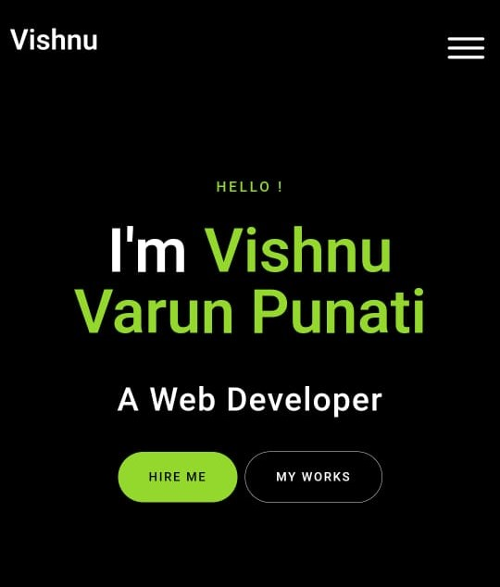
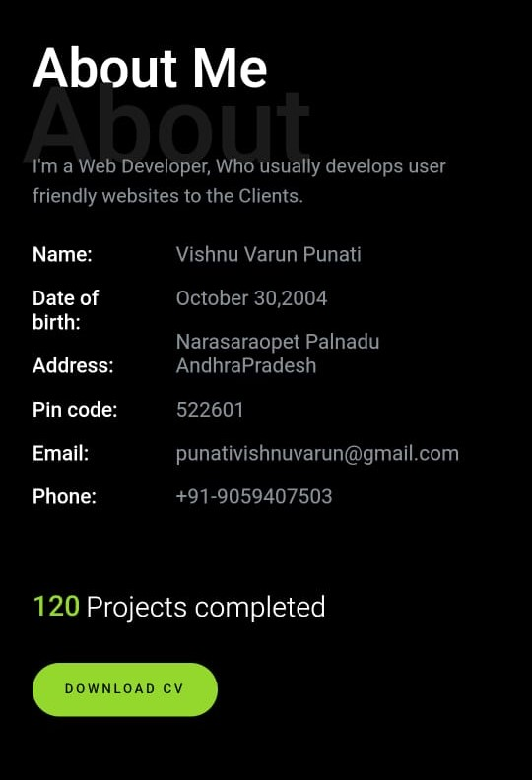
00
A PORTFOLIO WEBSITE
DEMO
01

Slide 8
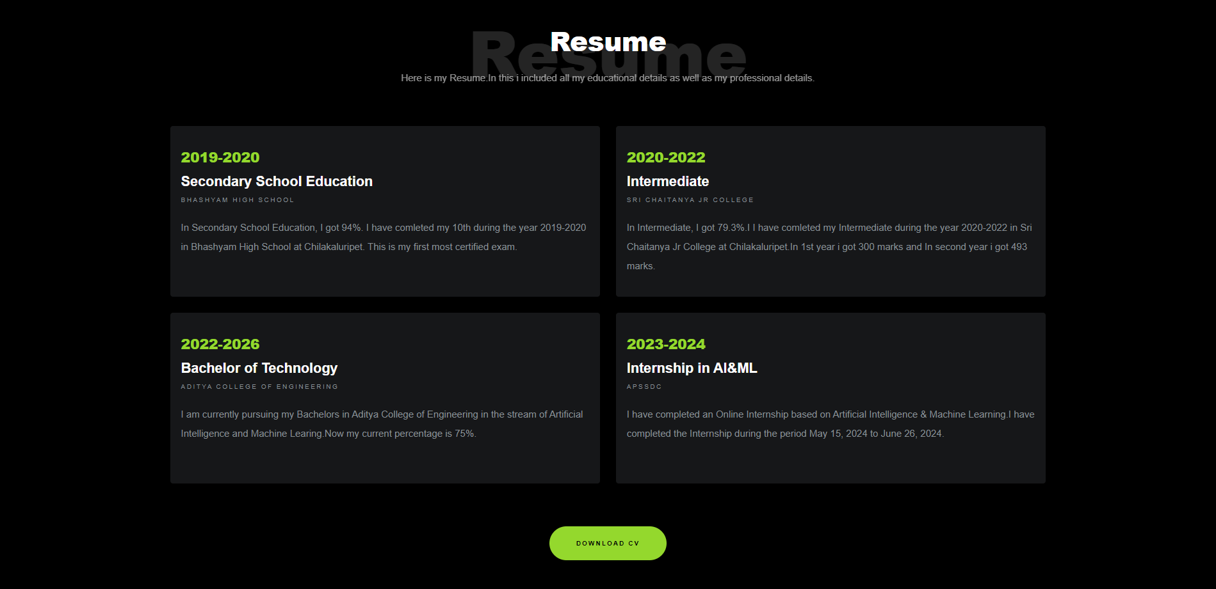
00
A PORTFOLIO WEBSITE
DEMO
01

Slide 9
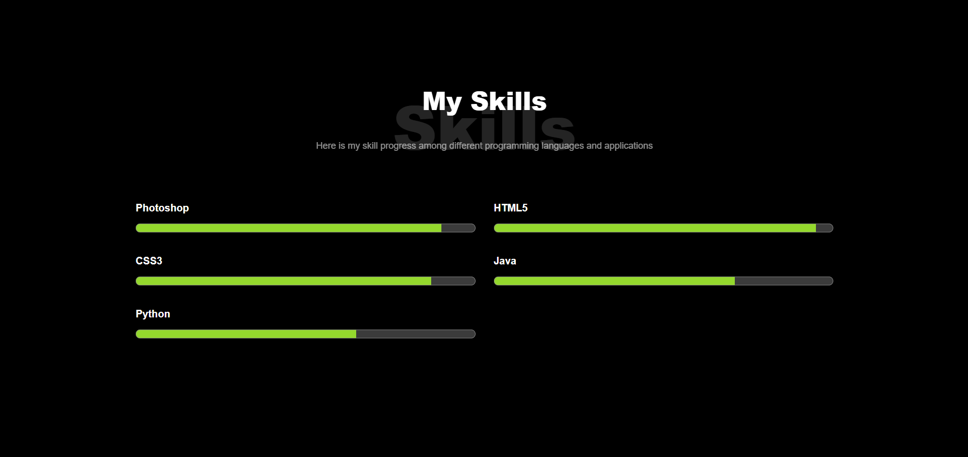
00
A PORTFOLIO WEBSITE
DEMO
01

Slide 10
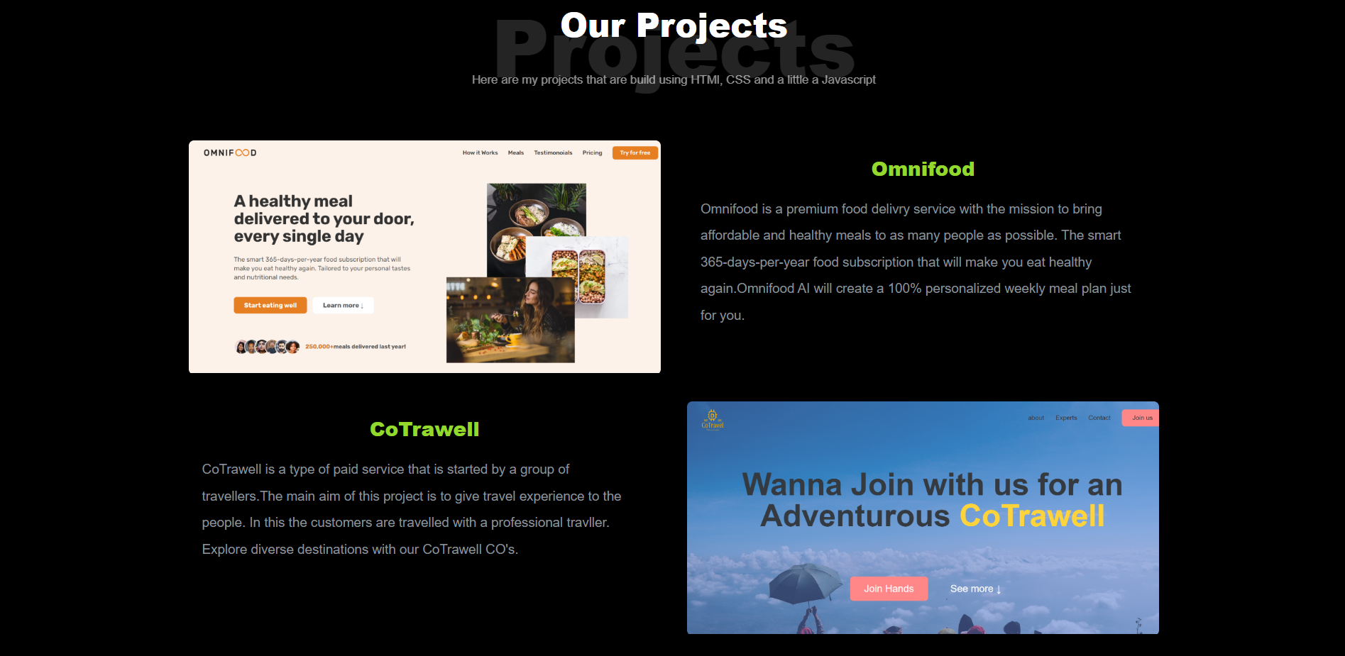
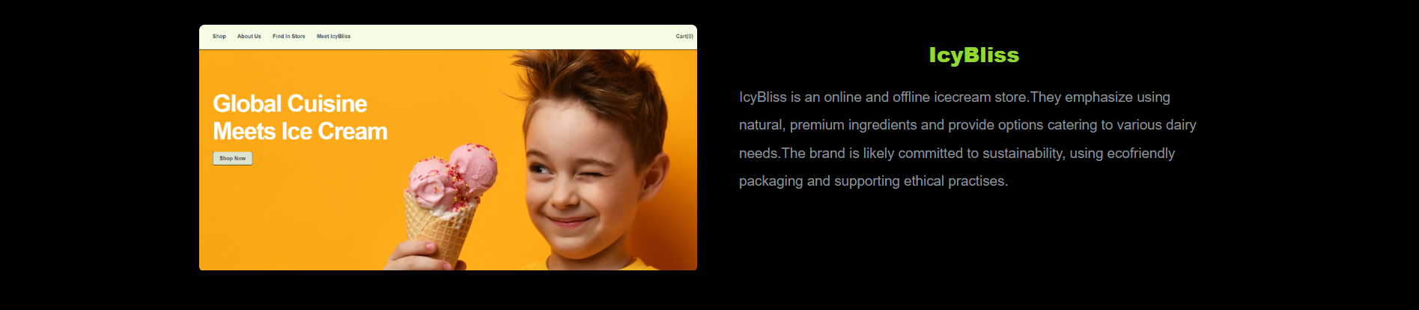
00
A PORTFOLIO WEBSITE
DEMO
01

Slide 11
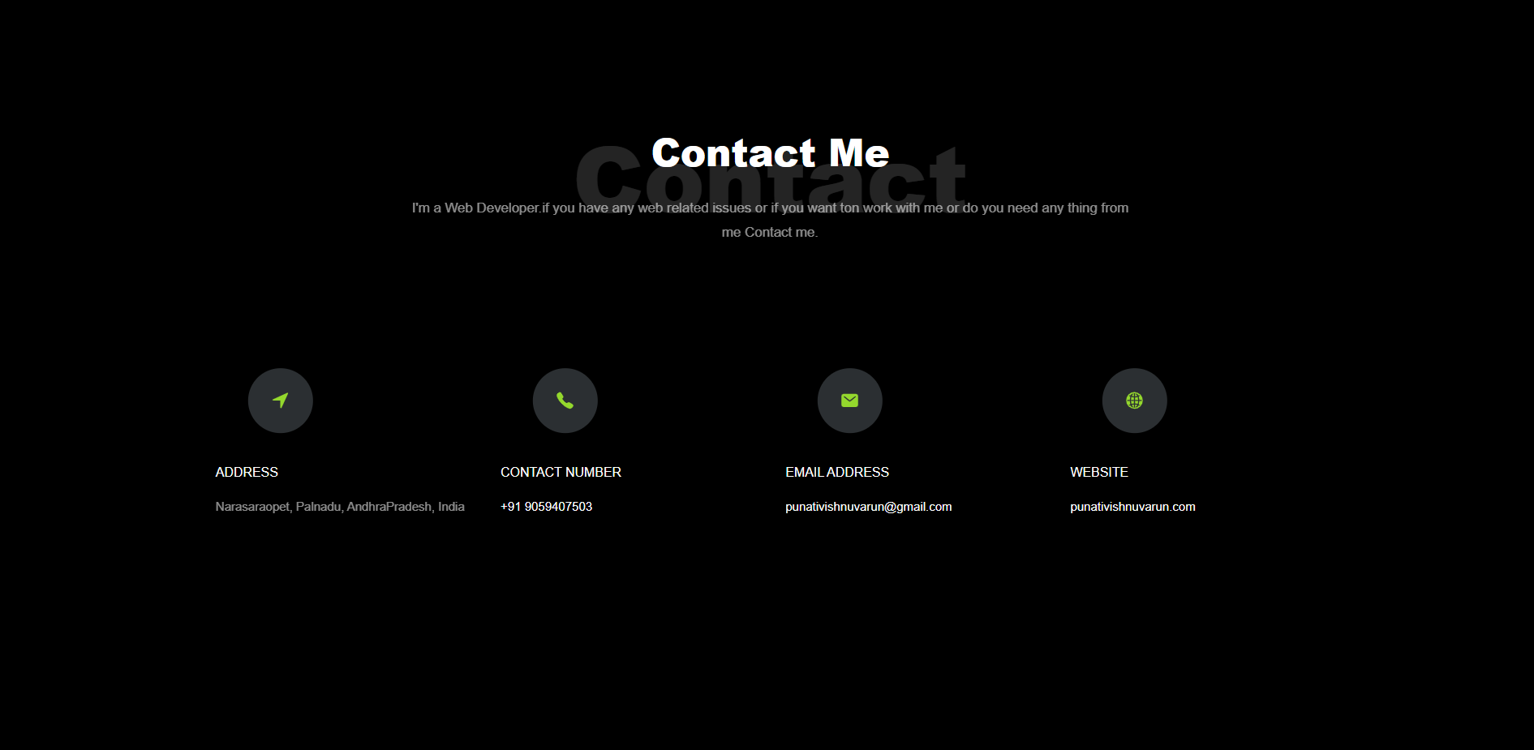
00
A PORTFOLIO WEBSITE
DEMO
01

Slide 12
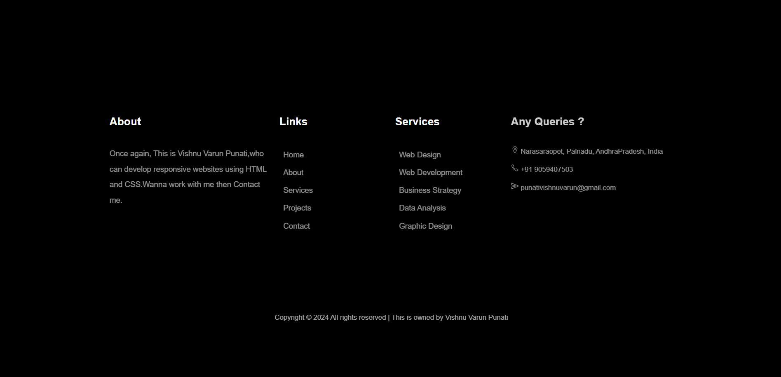
00
A PORTFOLIO WEBSITE
DEMO
01

Slide 13

05
ANY QUERIES....?
What is the use of Potfolio
It helps in requiter to have a visual representation of skills, projects, achivements that the user has.
What are the items in Portfolio
Portfolio includes Information about user, skills he/she had, projects made by them and achivements done by them.
How does it helpful
A Portfolio is very useful because it shows off your skills and experience through examples of your work.

Slide 14
CONCLUSION
A portfolio represents the user details such as educational details, qualifications , professional experiences , skills, projects, contact information etc. Actually for web developers and web designers portfolio is very important. Mostly this is enough for them to get hired or not.
From this internship, i have gained experience about making projects using HTML ,CSS and Javascript.This helped me a lot.

Slide 15
THANK YOU!
THANK YOU FOR WATCHING

